Slide 1

Week 8
Managed K8s – Amazon EKS

Slide 2
Assumptions
The actions below should be completed before we continue to Amazon EKS.
You received email from AWS and created your root credentials
You created a user with Admin permissions, the user has programmatic and console access
You logged out from your root account, switched to the user you created. From this point on, you will be using the user credentials, never root credentials.
You can work in us-east-1 and us-west-2 regions only, preference to us-east-1
Make sure budget alerts are set up. The monthly projected limit should be set to 30USD. Please reach out if you do not see budget alert set up in the CloudWatch service

Slide 3
Important Notes
AWS Academy does not allow use of Amazon EKS now. I will not address any questions related to use of AWS Academy until the end of the term
The instances are not stopped programmatically in the new environment. It is your responsibility to stop the instances and delete the control plane nodes.
The budget in the new environment is not limited programmatically. It is your responsibility to keep the budget under control
If your projected monthly budget will be over 30USD, I will get notified and will forward you the notification. Please act upon it immediately and delete all the running clusters and instances
The second time I receive the budget alert for your account, I will disable your account immediately. From this point, you will have to use your own AWS account or find a way to work with AWS Academy

Slide 4
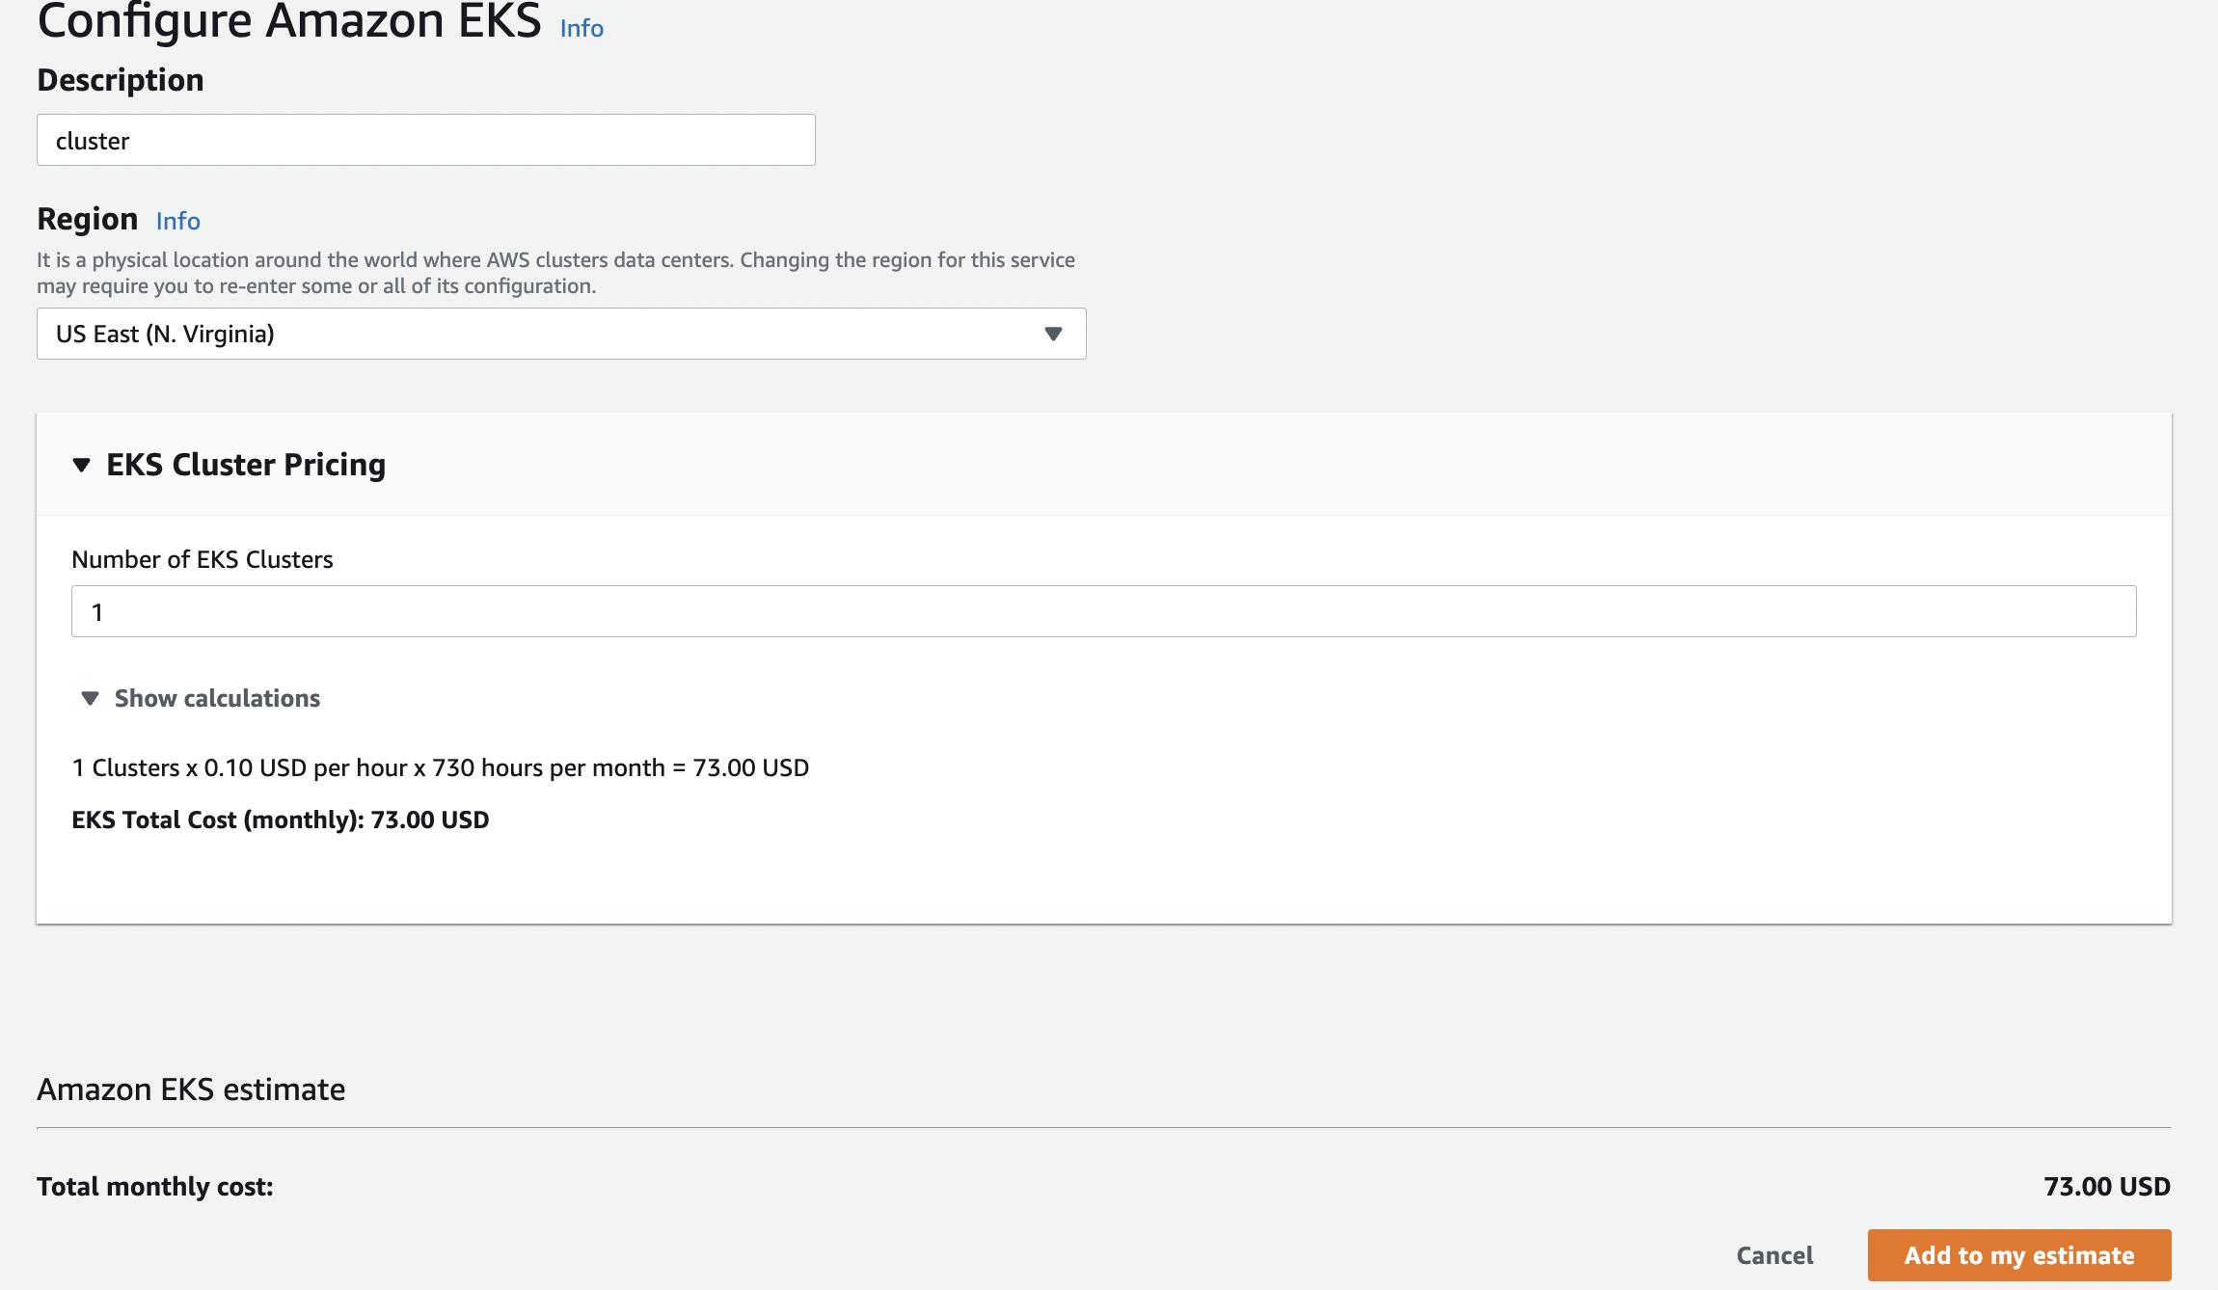
Cluster COST Estimate – Control Plane Only!

Slide 5
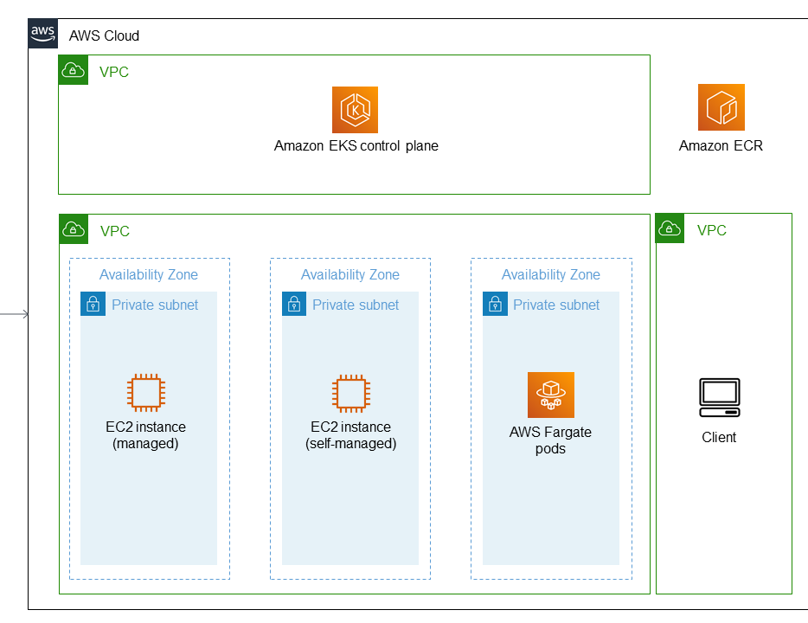
Amazon EKS - High level Architecture
Master nodes are running in AWS VPC, not in our VPC
Amazon EKS API server can be either private or publicly accessible
Worker nodes can be self-managed or AWS managed
Notes:
https://docs.aws.amazon.com/prescriptive-guidance/latest/containers-provision-eks-clusters-terraform/requirements-code-repository.html
https://www.eksworkshop.com/beginner/170_statefulset/services/

Slide 6
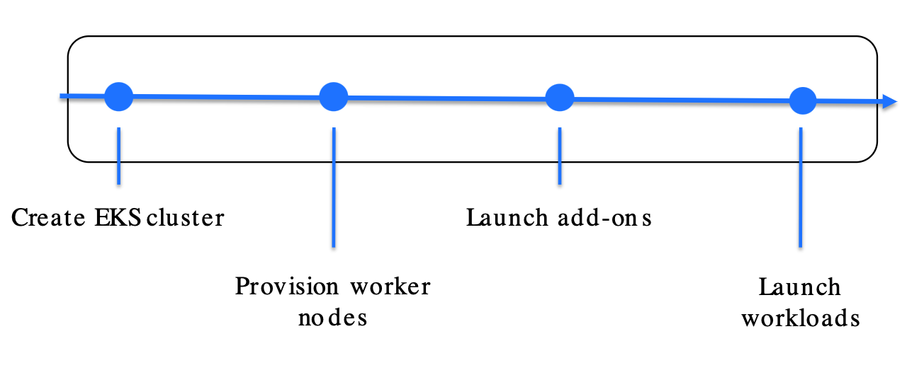
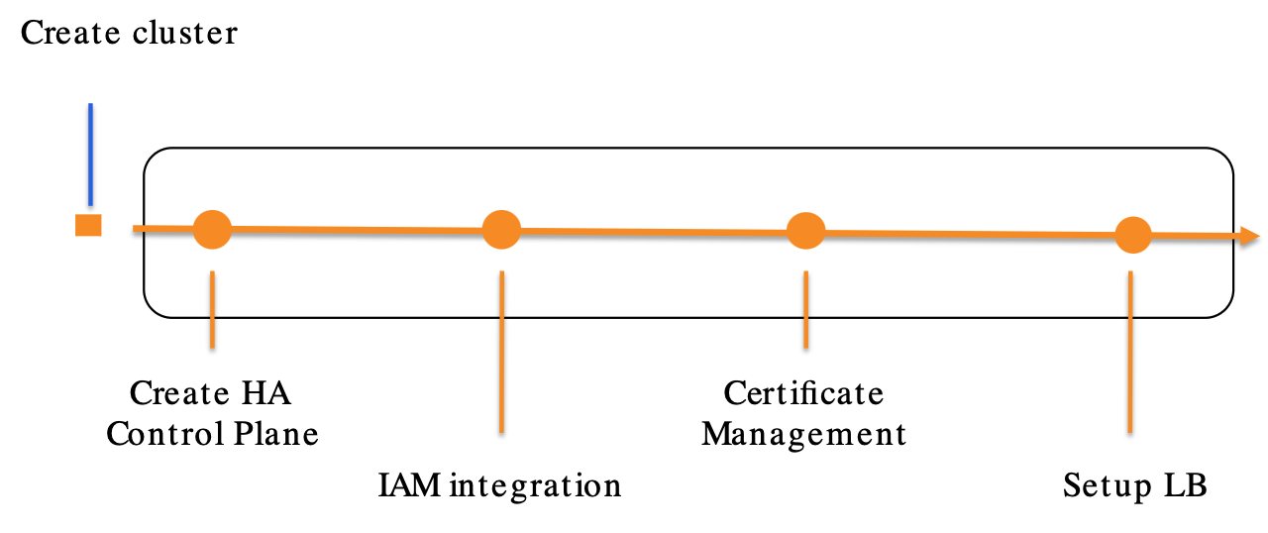
Amazon EKS Cluster creation

Slide 7
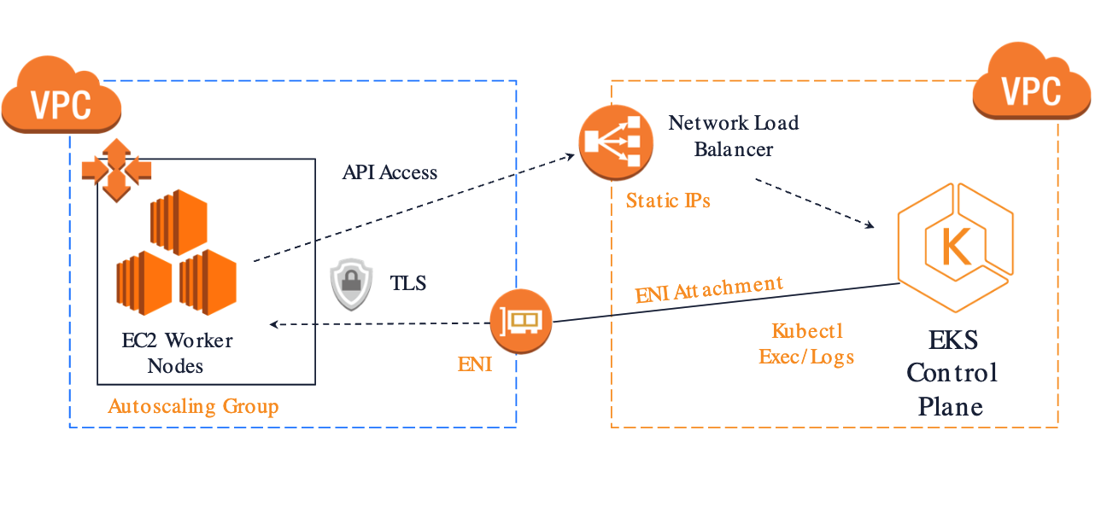
EKS ARCHITECTURE FOR CONTROL PLANE AND WORKER NODE COMMUNICATION

Slide 8
Workshop 1 – Creating Amazon eks cluster with eksctl

Slide 9
Goals
Installing pre-requisites and configuring Cloud9 environment
Configuring local environment
Deployment K8s dashboard
https://www.eksworkshop.com/010_introduction/
Notes:
https://www.eksworkshop.com/beginner/170_statefulset/services/

Slide 10
Increase disk space of Cloud9 Environment
https://www.eksworkshop.com/020_prerequisites/workspace/
The commands are available in Week8-Document.
Please note that we are not following all the workshop instructions.

Slide 11


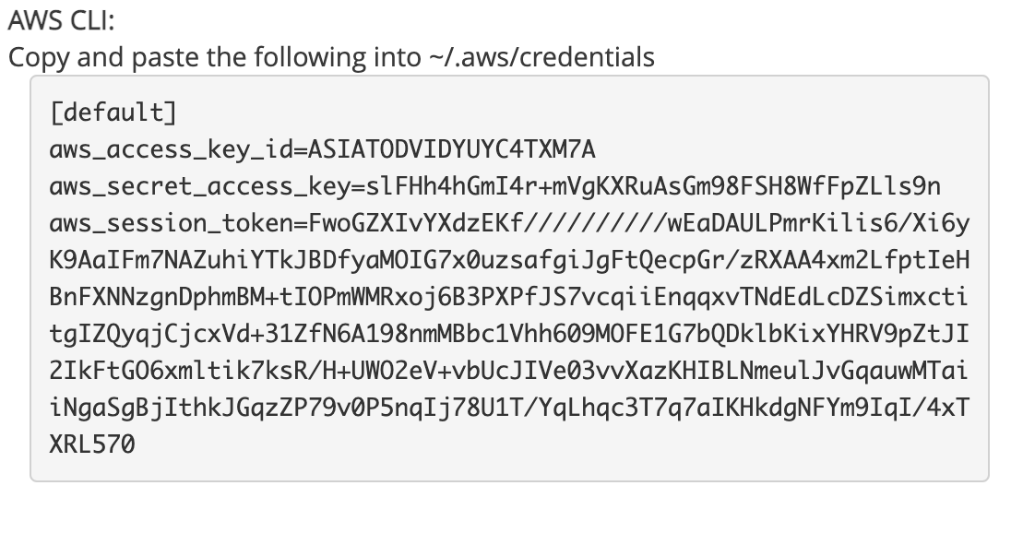
Disable temporary credentials
# Make sure you are using AWS CLI version 2. Use these instructions to update the AWS CLI version in your Cloud9 environment.
$ /usr/local/bin/aws –-version
# Configure your permanent credentials and disable Cloud9 temporary credentials
$ /usr/local/bin/aws cloud9 update-environment --environment-id $C9_PID --managed-credentials-action DISABLE
$ rm -vf ${HOME}/.aws/credentials
# Copy and paste the following credentials from AWS Academy into ~/.aws/credentials in Cloud9

Slide 12
Installing pre-requisites
Install kubectl - https://docs.aws.amazon.com/eks/latest/userguide/install-kubectl.html
Install eksctl - https://docs.aws.amazon.com/eks/latest/userguide/eksctl.html
Configure your permanent credentials and disable Cloud9 temporary credentials
Update eks_config.yaml with your account id
Create the cluster - this step will take a few minutes
Update your Kube config
Optional
Increase disk space of Cloud9
Install jq
Update AWS CLI
Install bash completion
Add kubectl alias
Set loadBalancer Controller version
Enable eksctl bash completion

Slide 13
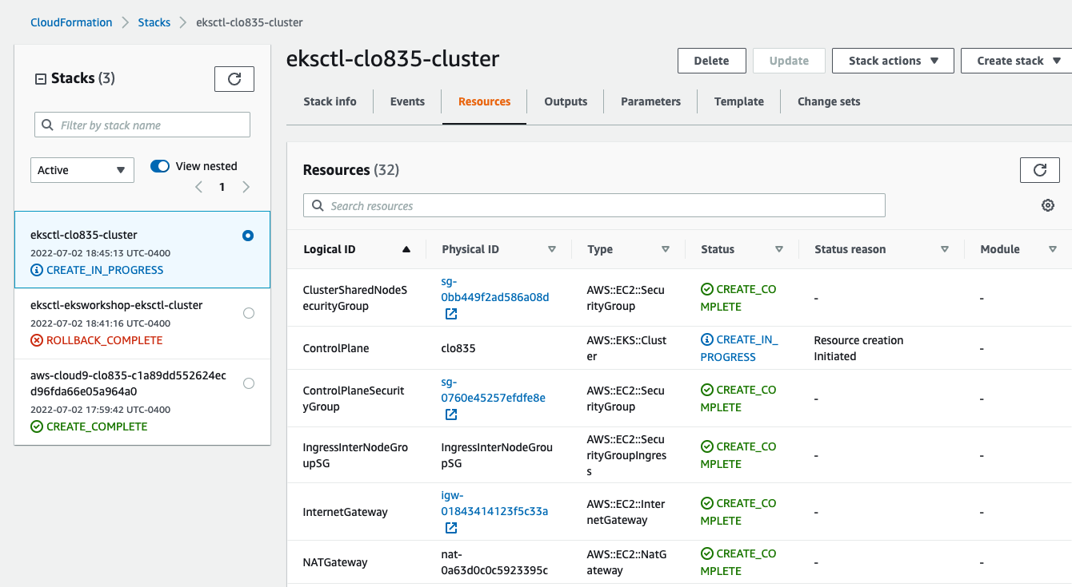
Explore The created Resources with CloudFormation

Slide 14
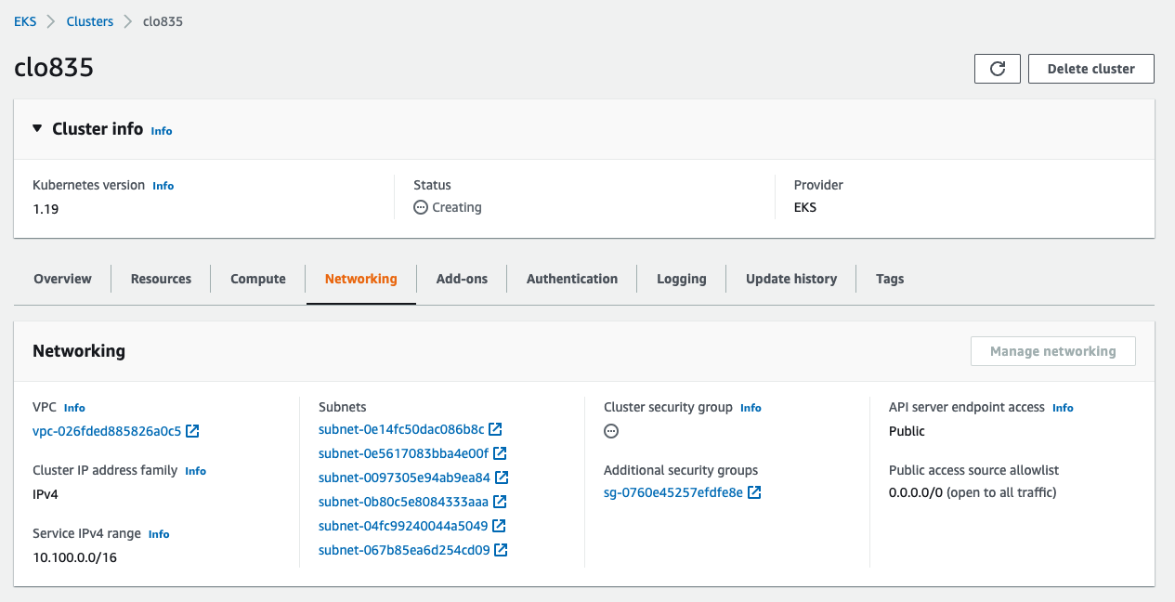
Explore The Created cluster with Amazon EKS

Slide 15
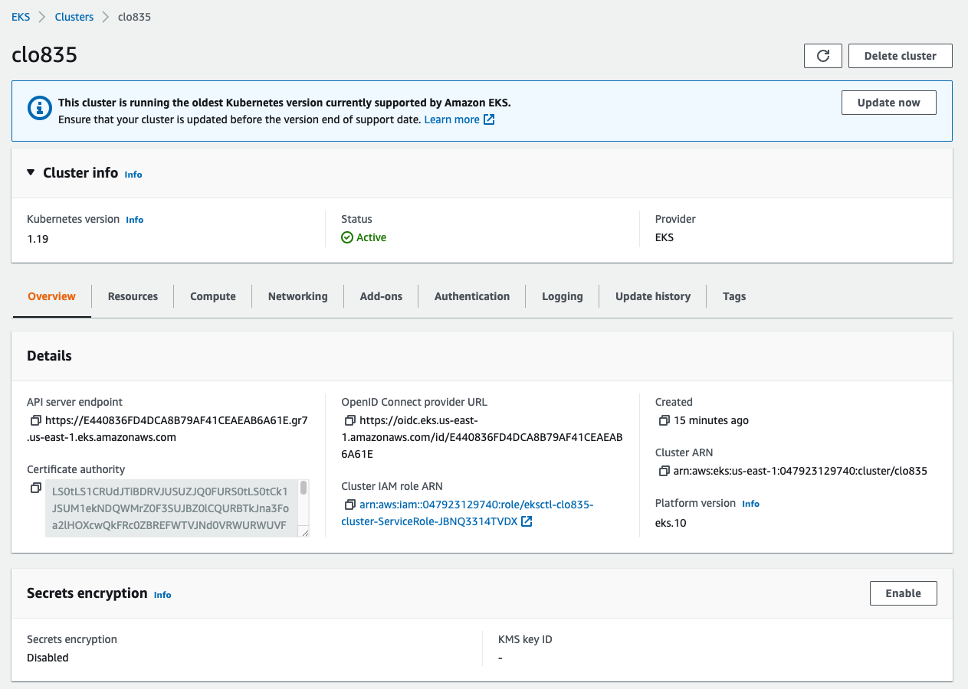
Cluster is ready – What runs in the cluster?
Examine the cluster in AWS Console

Slide 16
Use Kubectl to work with amazon EKS
# Can we use kubectl command?
k get nodes
# Update ~/.kube/config
aws eks update-kubeconfig --name clo835 --region us-east-1

Slide 17
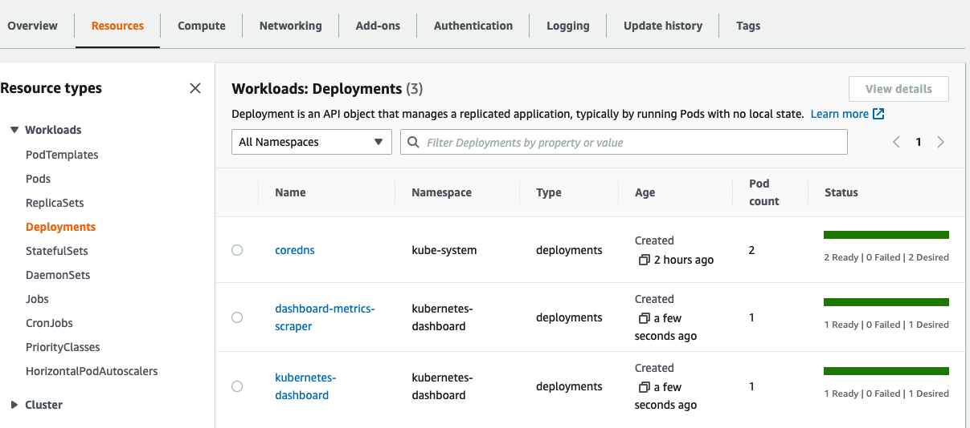
Deploy k8s dashboard
export DASHBOARD_VERSION="v2.0.0"
kubectl apply -f https://raw.githubusercontent.com/kubernetes/dashboard/${DASHBOARD_VERSION}/aio/deploy/recommended.yaml
k get all -n kubernetes-dashboard

Slide 18
View the Dashboard from cloud9
Since this is deployed to our private cluster, we need to access it via a proxy. kube-proxy is available to proxy our requests to the dashboard service. In your workspace, run the following command:
kubectl proxy --port=8080 --address=0.0.0.0 --disable-filter=true &
This will start the proxy, listen on port 8080, listen on all interfaces, and will disable the filtering of non-localhost requests.
This command will continue to run in the background of the current terminal’s session.

Slide 19
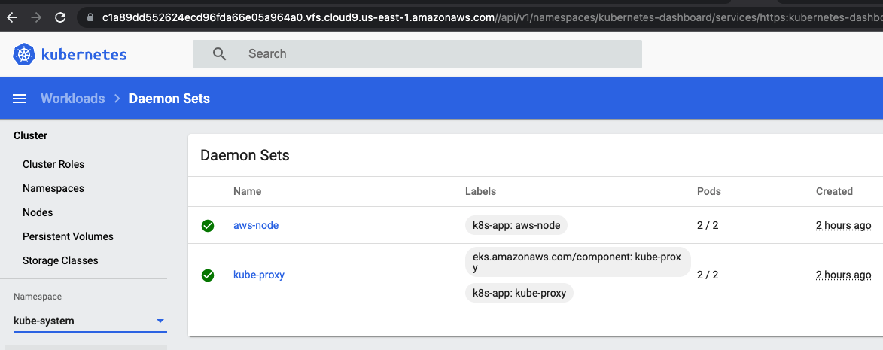
Exploring Kubernetes Dashboard
Now we can access the Kubernetes Dashboard
In your Cloud9 environment, click Tools / Preview / Preview Running Application
Scroll to the end of the URL and append:
/api/v1/namespaces/kubernetes-dashboard/services/https:kubernetes-dashboard:/proxy/
The Cloud9 Preview browser doesn’t appear to support the token authentication, so once you have the login screen in the cloud9 preview browser tab, press the Pop Out button to open the login screen in a regular browser tab, like below:
Open a New Terminal Tab and enter
aws eks get-token --cluster-name clo835 | jq -r '.status.token'
Copy the output of this command and then click the radio button next to Token then in the text field below paste the output from the last command.
Then press Sign In.
Notes:
https://www.eksworkshop.com/beginner/040_dashboard/connect/

Slide 20
End of Workshop 1

Slide 21
Volume Lifecycle
The lifecycle of a volume is linked to the pod's lifecycle
This means that a volume is created when the pod is created
This is mostly relevant for emptyDir volumes
(other volumes, like remote storage, are not "created" but rather "attached" )
A volume survives across container restarts
A volume is destroyed (or, for remote storage, detached) when the pod is destroyed

Slide 22
Workshop 2 – Deployment of our first application To Amazon EKS
Notes:
https://github.com/luksa/kubernetes-in-action/tree/master/Chapter06

Slide 23
Goals
Deployment of containerized application that uses emptyDir Volume to share data between containers
Serving the application to external users with LoadBalancer service
Notes:
https://www.eksworkshop.com/beginner/170_statefulset/services/

Slide 24
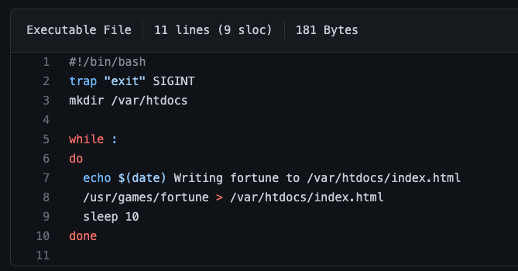
Description
Application is running as two containers in the same pod
One process is generating random fortune every 10 seconds and writes it to a shared volumes
The same volume is mounted into nginx container as /usr/share/nginx/html. Nginx serves the fortunes from this folder
Notes:
https://www.eksworkshop.com/beginner/170_statefulset/services/
https://github.com/luksa/kubernetes-in-action/tree/master/Chapter06

Slide 25

Description
Application is running as two containers in the same pod
One process is generating random fortune every 10 seconds and writes it to a shared volumes
The same volume is mounted into nginx container as /usr/share/nginx/html. Nginx serves the fortunes from this folder
Notes:
Pp 164 in K8s in action

Slide 26
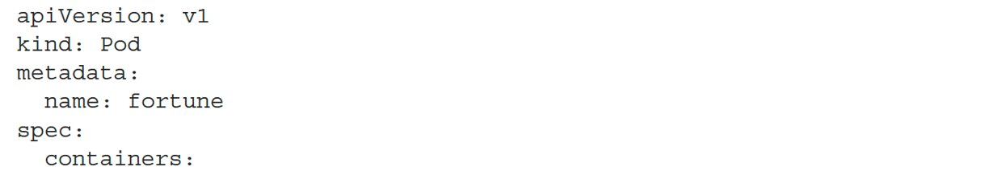
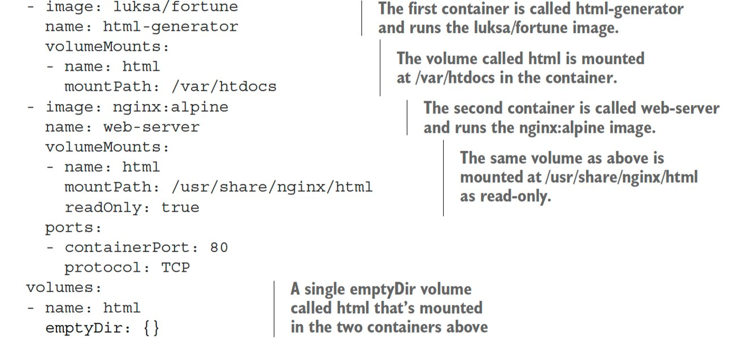
Pod Manifest

Slide 27
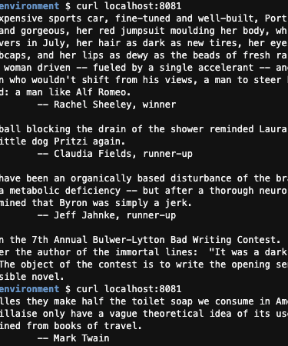
Deploy and Access the application
# Create a namespace
$ k create ns week8
$ k apply -f fortune_pod.yaml -n week8
$ k get all –n week8
# Deploy the pod
# Access the app via port forwarding
$ kubectl port-forward fortune 8080:80 -n week8
$ curl http://localhost:8080
Notes:
htt

Slide 28

Examine the mounted volume
# Attach shell to web-server container inside fortune Pod
$ k exec fortune -it -n week8 -c web-server -- sh
/ # cat /usr/share/nginx/html/index.html
Try the Moo Shu Pork. It is especially good today.
# Wait 10 seconds
/ # cat /usr/share/nginx/html/index.html
You will be run over by a beer truck.
# Try upating the index.html file
/ # vi /usr/share/nginx/html/index.html
Why does the editing attempt fail?

Slide 29
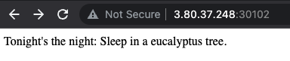
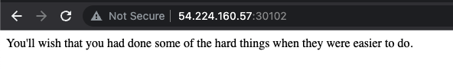
Expose Fortunes via NodePort
$ k expose pod fortune -n week8 --type NodePort -n week8
# K8s assigned a NodePort randomly. There only one pod and 2 nodes.
# What IP should we use to access the application?
# The IPs of both nodes respond. Why?

Slide 30
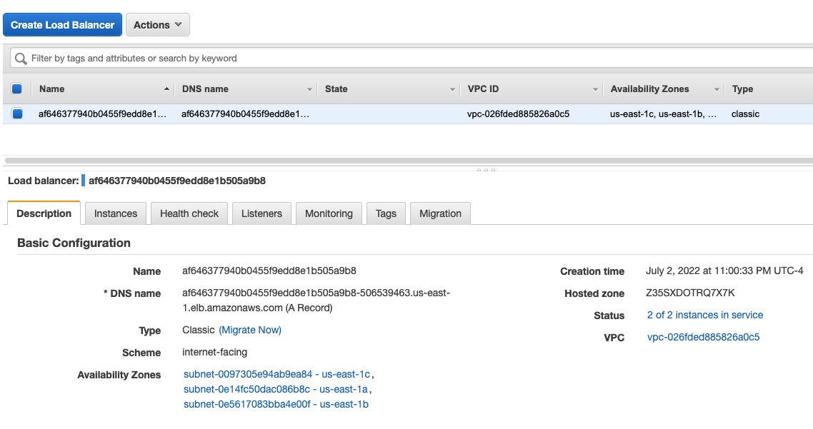
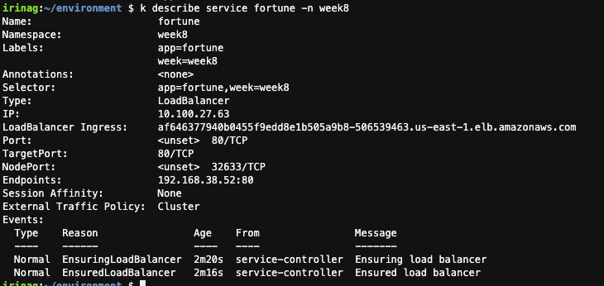
Expose Fortunes via LoadBalancer
$ k delete service fortune -n week8
$ k expose pod fortune -n week8 --type LoadBalancer -n week8

Slide 31
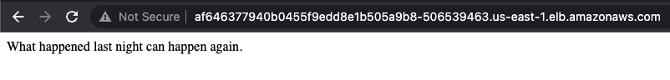
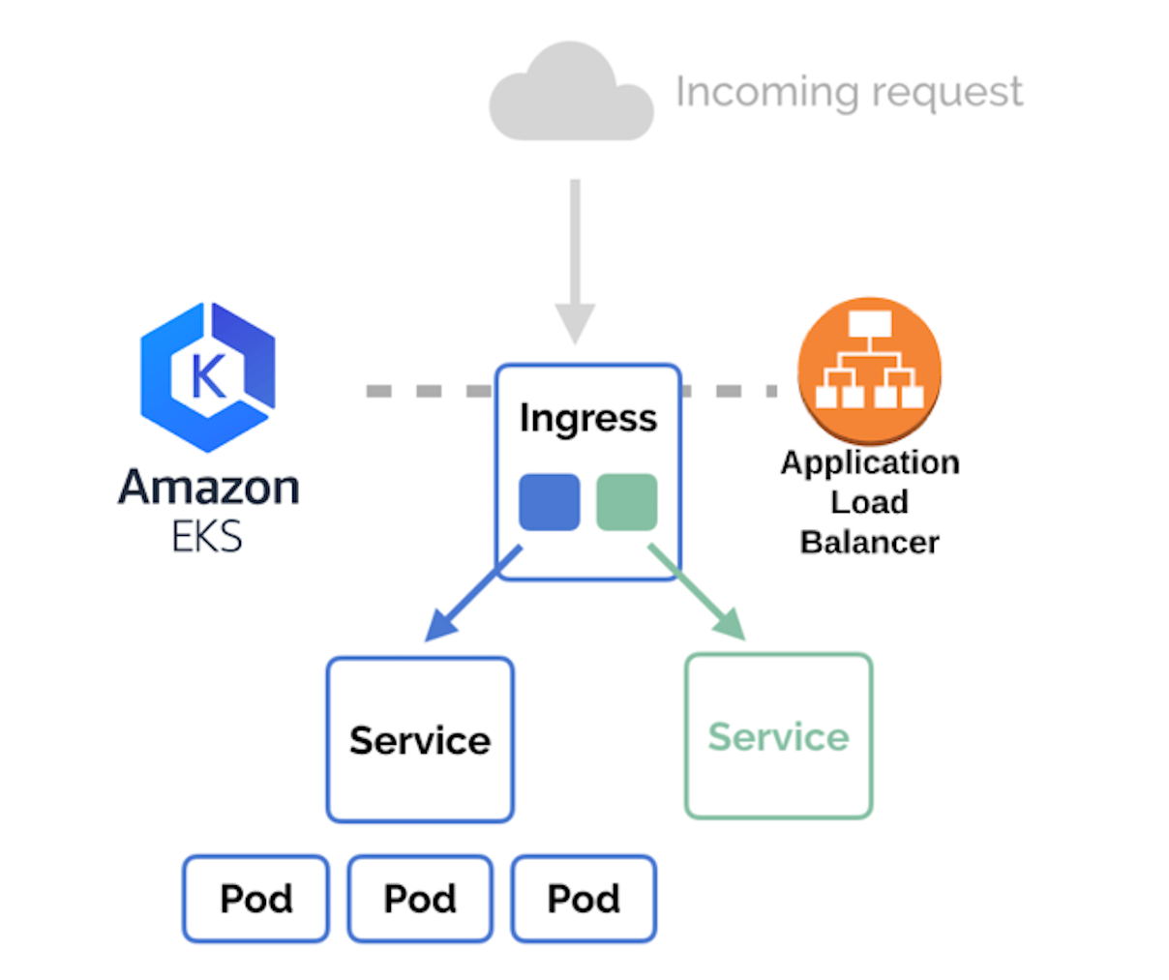
Expose Fortunes via LoadBalancer

Slide 32
End of Workshop 2

Slide 33
Additional Reading
https://kubernetes.io/docs/concepts/storage/volumes/
https://kubernetes.io/docs/tasks/configure-pod-container/configure-volume-storage/
https://aws.amazon.com/premiumsupport/knowledge-center/eks-persistent-storage/
https://docs.giantswarm.io/getting-started/persistent-volumes/aws/
https://github.com/weaveworks/eksctl/tree/main/examples
https://eksctl.io/

